Slide 1
Battle of Neighborhoods

Slide 2
Objective
To open Burger Joint in some Locality (District) of Bogotá, Colombia on best possible location so that revenue/sales may be maximized.

Slide 3
Data Used:
To help Jeronimo in his search we will need to access following data:
The Localities of Bogotá, Colombia from Wikipedia: https://es.wikipedia.org/wiki/Anexo:Localidades_de_Bogot%C3%A1
The coordinates (latitude, longitude) of these Localities of Bogotá from Open Street Map APIs
From Foursquare we will need following venues data:
The burger joint venues of the Localities
The offices venues of the Localities
The high schools’ venues of the Localities
The universities venues of the Localities
We will then leverage the data in order to determine which locality is the most appropriate in order to locate the burger joint.

Slide 4
Python packages and Dependencies:
Pandas - Library for Data Analysis
NumPy – Library to handle data in a vectorized manner
Geopy – To retrieve Location Data
Requests – Library to handle http requests
Matplotlib – Python Plotting Module
Sklearn – Python machine learning Library
Folium – Map rendering Library

Slide 5
Methodology:
For each locality, all office, school, university and burger joints venues data have been collected from Foursquare.
Then for each locality, the sums of the office, school, university and burger joints were computed.
For each of these four categories, a weight (or penalty) has been defined according to what Jeronimo considers the most important.
Burger Joints have been weighted with -1, since Paolo wants to avoid concurrence.
Schools have been weighted with 1, since student are good customers.
Universities have been weighted with 1.5, since students are good customers.
Offices have been weighted with 2, since employees are even better customers.

Slide 6
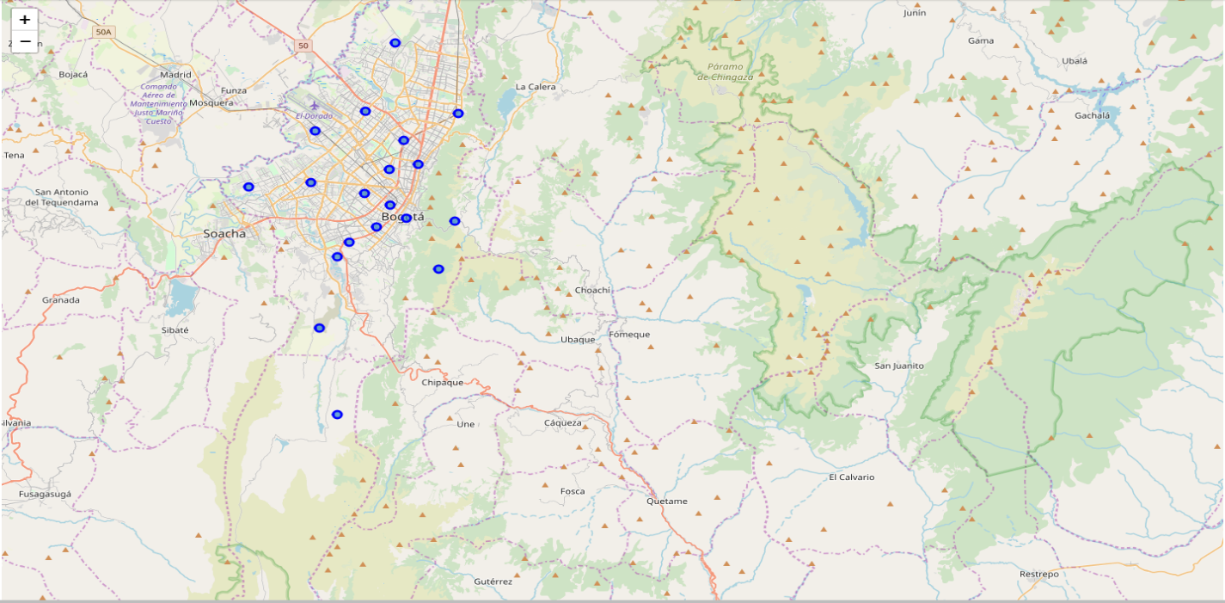
Localities of Bogotá, Colombia

Slide 7
Localities of Bogotá, Colombia

Slide 8
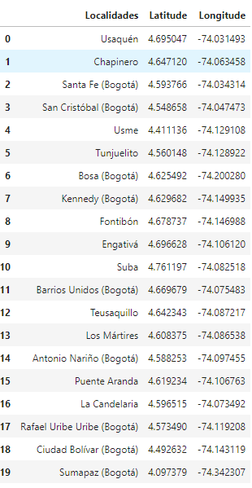
Localities of Bogotá, Colombia

Slide 9
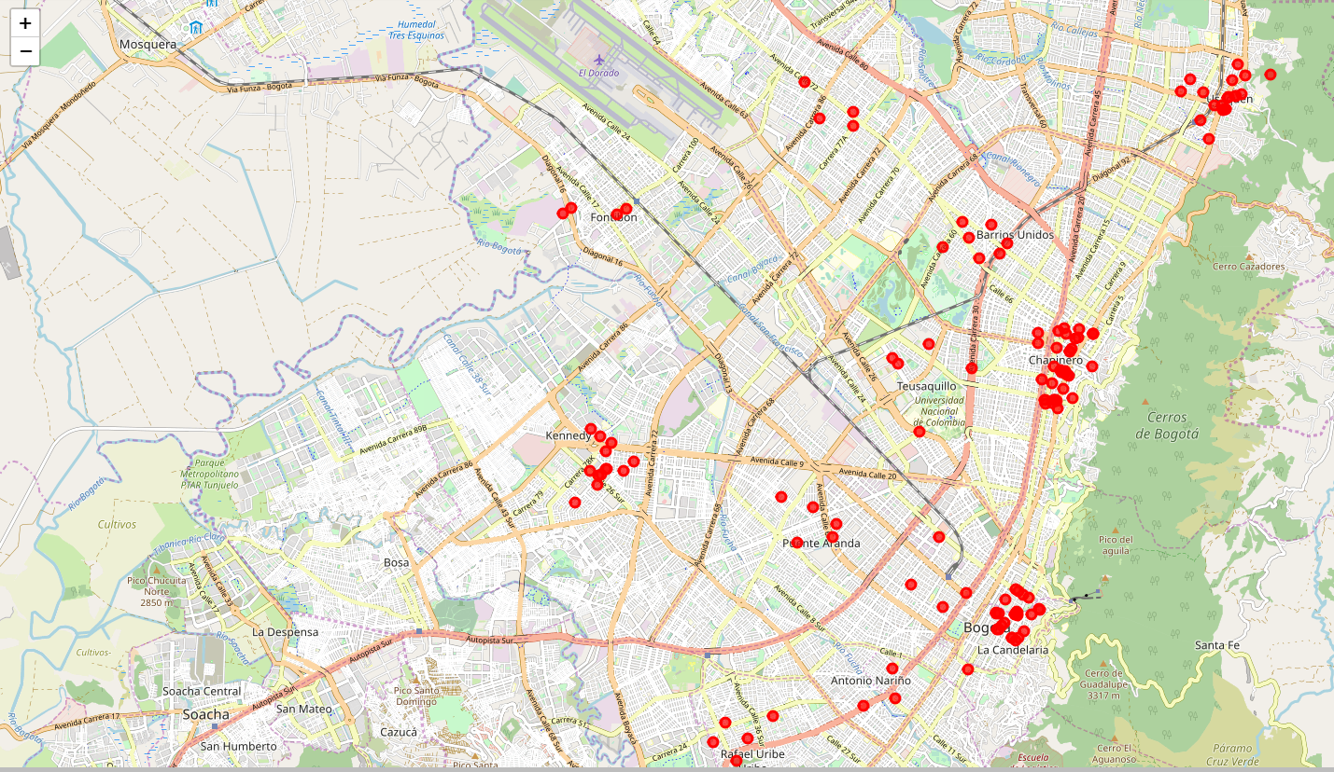
Burger Joints in Bogotá Localities

Slide 10
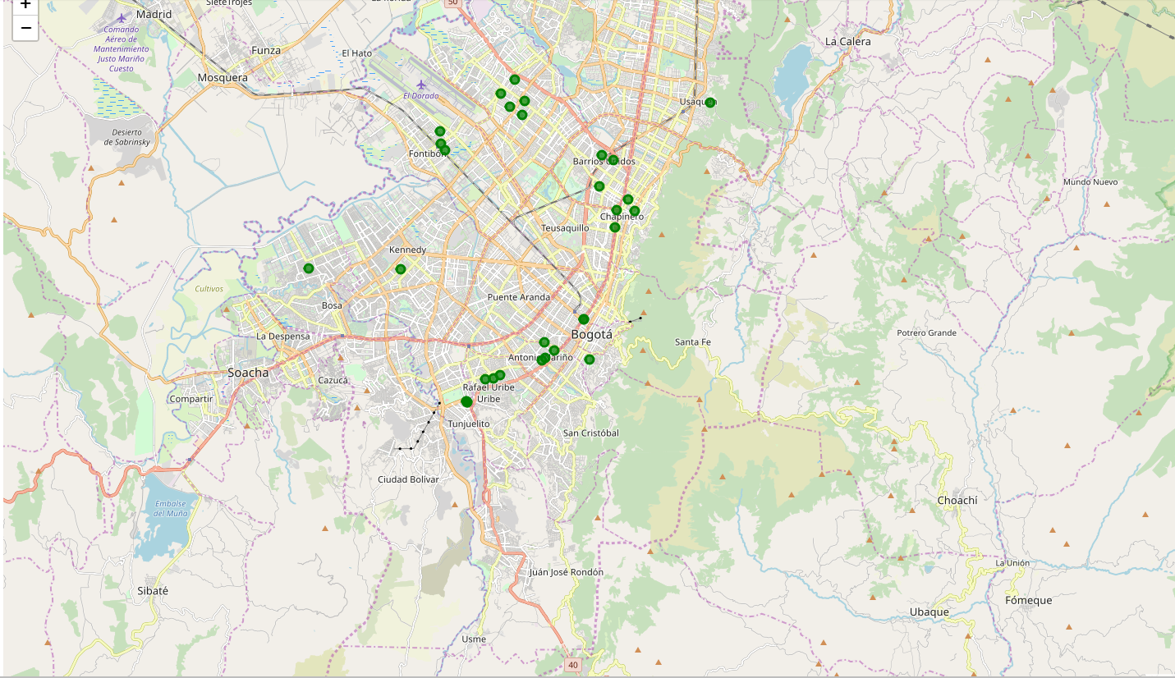
High School in Bogotá Localities

Slide 11
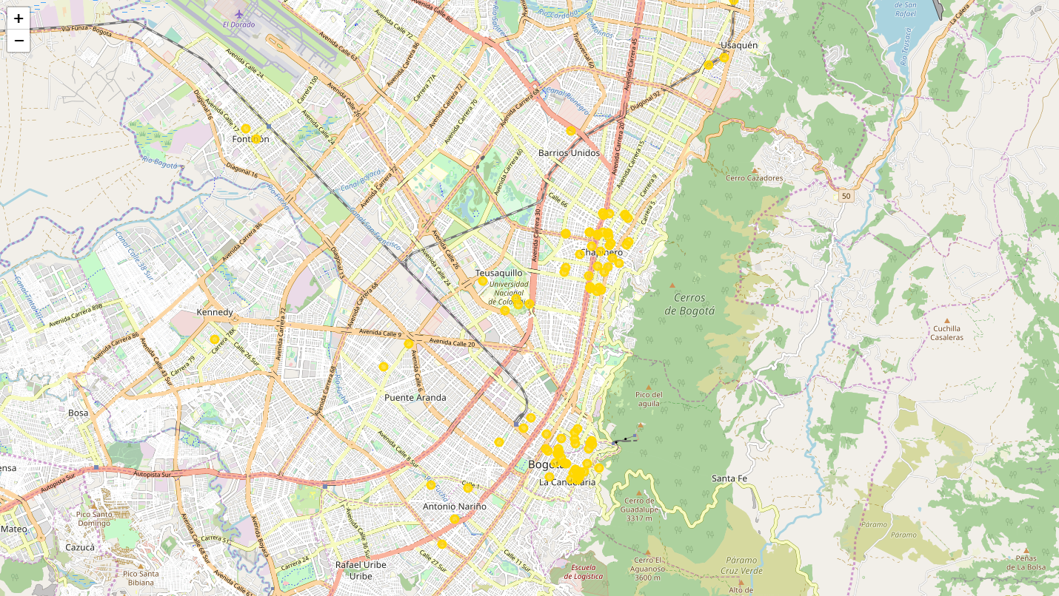
Universities in Bogotá Localities

Slide 12
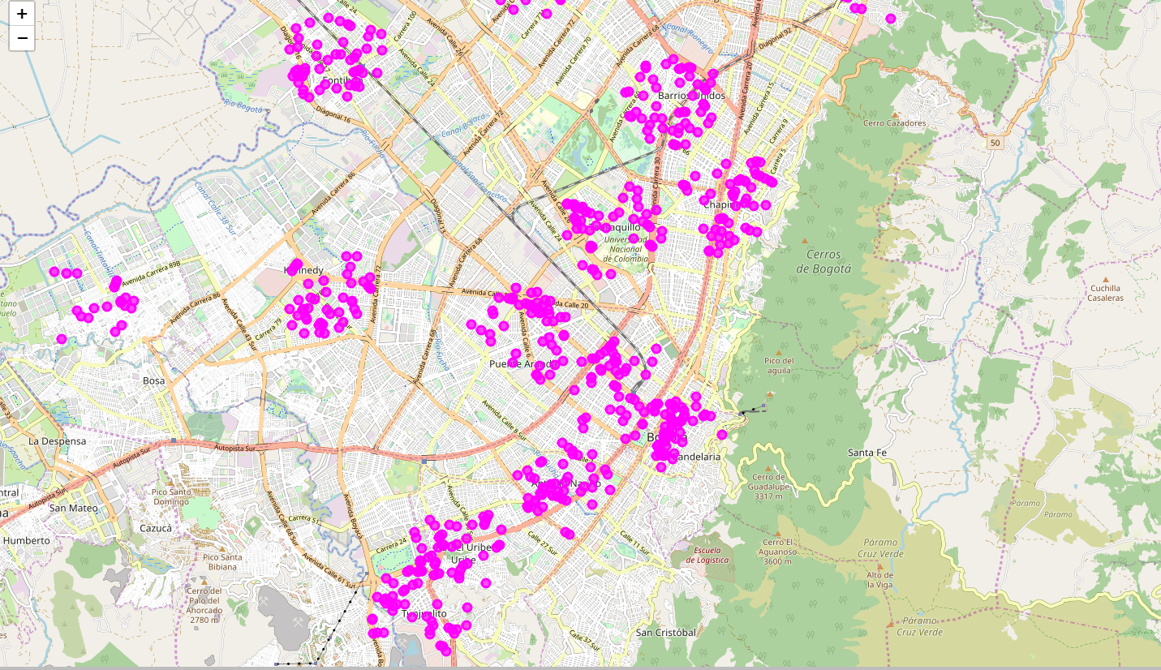
Offices in Bogotá Localities

Slide 13
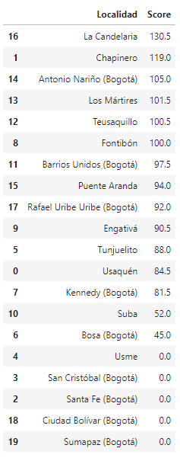
Results:
Conclusion:
The Locality with the best score is “La Candelaria” with 130.5, being the best option.
Follows closely “Chapinero” with 101.
These options maximizes the number of potential customers from offices and universities and at the same time have not too large competence.

Slide 14
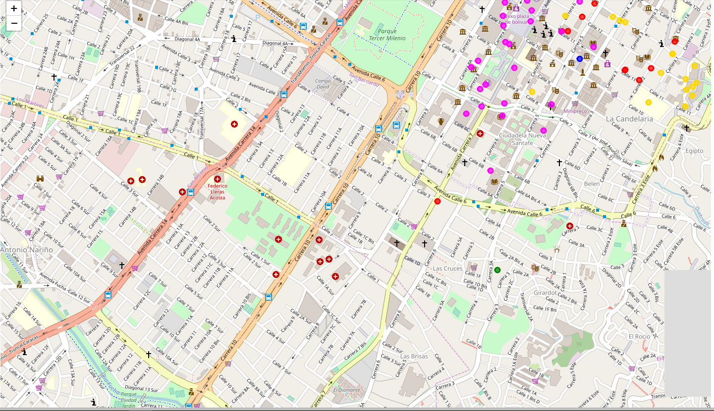
Best Place for the Burger Joint in Bogotá is “La Candelaria”:

Slide 15
Recommendation:
The following analysis can be improved with following extensions:
Consider more categories. For example like "Night life" which is also a good source for customers. But also like "Restaurants", which even if not burger joints may be some concurrence if too many.
In the Locality itself, it can also be computed the distance between all the venues in order to find a place with the most number of potential customers.
Using smaller geographical areas like Neighborhoods could improve the accuracy for the scores.

Slide 16
Thank you

